Slide 1
SYST28951- System Development Methodologies
Deliverable 4 - Group Presentation

Slide 2
NORVS
Group members
Steven Kebila (Group Leader)
Arashdeep Singh
Vali Mohammad
Zawad Hossain
CASE STUDY

Slide 3
NORVS System
New Requirements
System Structure
Designing
Wrap up
Notes:
Presentation content flow

Slide 4



Introduction to NORVS System
What is NORVS
Steven

Slide 5
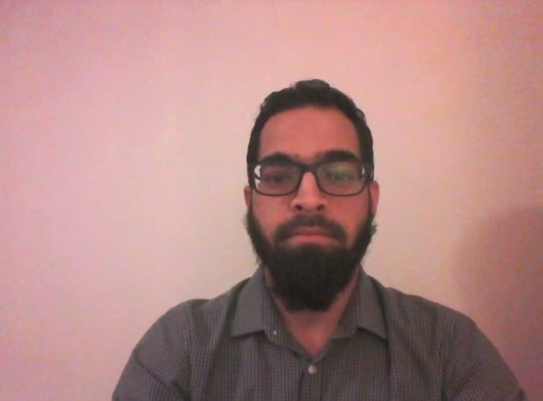
Current NORVS System
Business Activities | Manual System | Obstacles
Collecting client information |  | Prone to error
Client visiting or exiting the premises |  | Employee has to be present
Vehicles are being moved frequently |  | Updates not done properly misinformation are provided
Space allocation done using a magnetic board |  | Difficulty in publishing reports
Payment tracking and revenue recorded in registers |  | Encounter embarrassing situation
Zawad

Slide 6
NORVS System - User Requirements
Current System | Proposed System | Benefits
Collecting client information | Internet based system- Online form | Convenience and continuous connectivity
Client visiting the premises | Biometric scanners | System manage entry and exit
Vehicles are being moved frequently | Integrated storage management feature | System updates storage spaces immediately upon booking or releasing
Space allocation done using a magnetic board
Payment tracking in registers | Third party payment support | Flexibility in payment
Monthly revenue reports | Reporting feature | System generates monthly revenue reports, visitor logs, contract renewal
Zawad

Slide 7

System Structure
Client register
Provides personal and vehicle information
Check for storage
Creating rental agreement
No space available
No agreement created
Biometric scan and then Payment
Vali
Payment successful
Space Allocated

Slide 8
System Structure (Management side)
Management
Login to client profile
Add swap or Merge space
Manage entry logs
Report management
Vali
Notes:
Presentation content flow

Slide 9

UI Design in NORVS system.

Slide 10
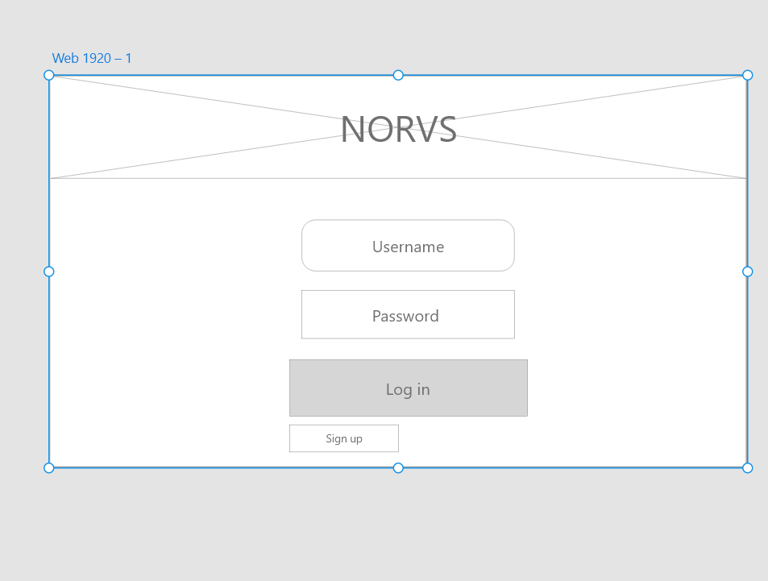
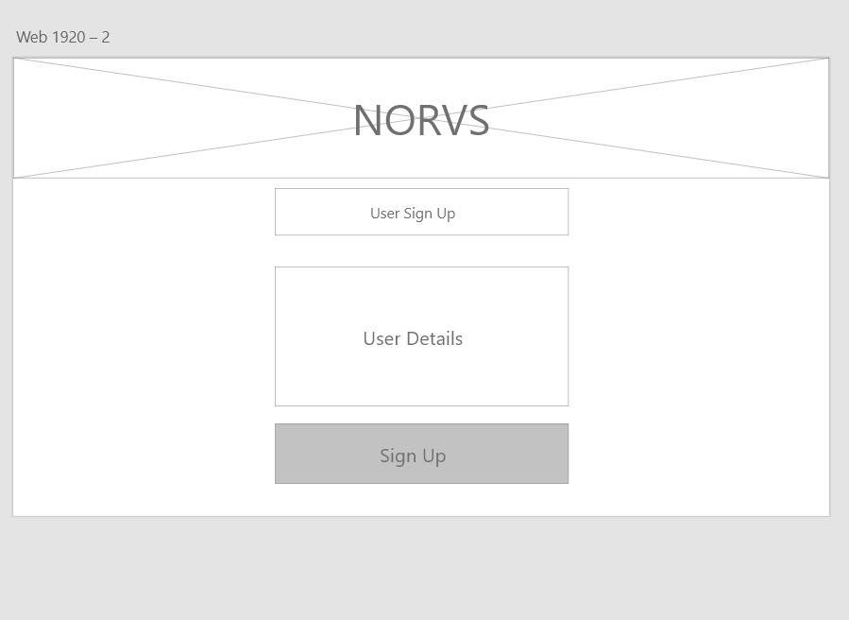
Create client profile(1/2)
Login page
Sign up page

Slide 11
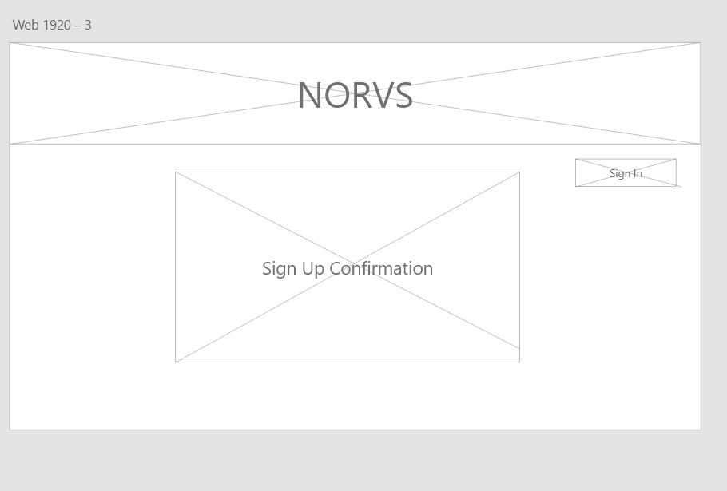
Create client profile(2/2)
At, last system will show confirmation.

Slide 12
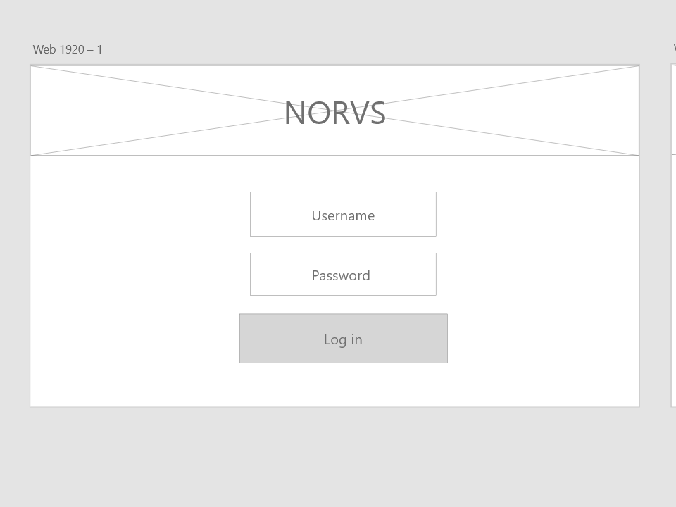
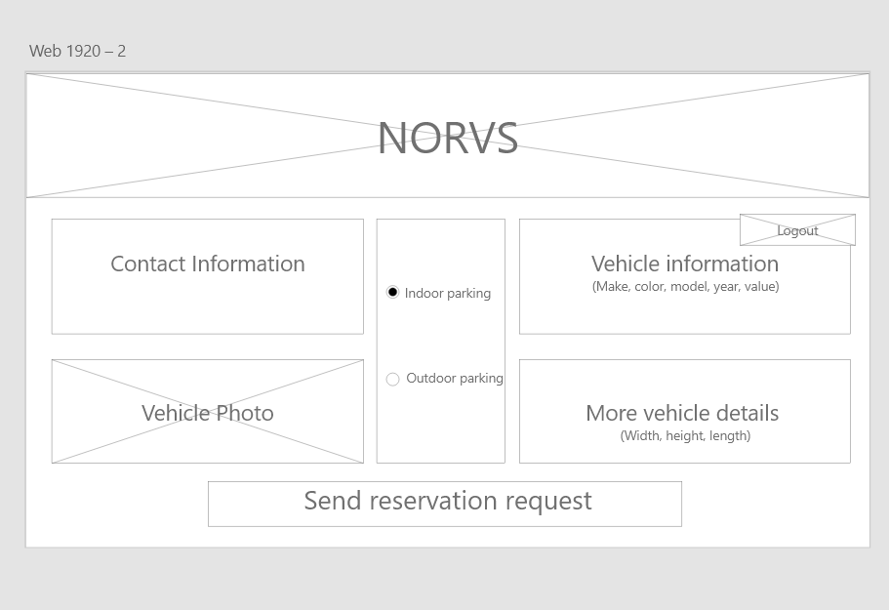
Provide Vehicle Information(1/2)
Login page
Reservation request

Slide 13
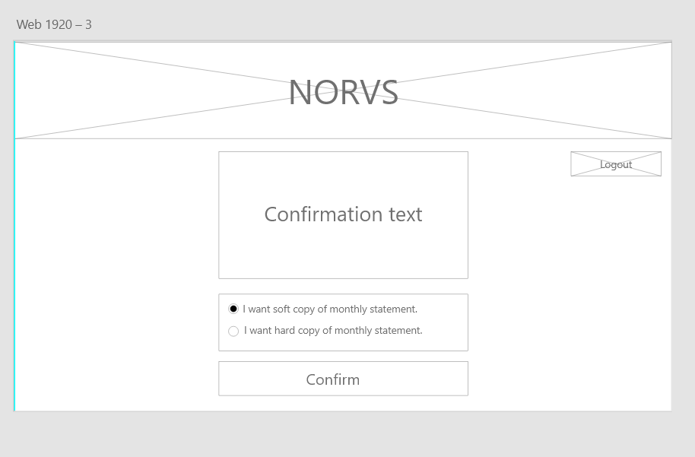
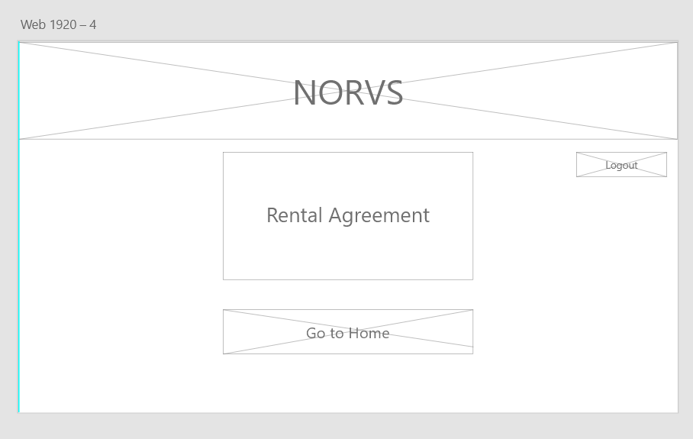
Provide Vehicle Information(2/2)
User chooses type of monthly statement here.
Final rental agreement

Slide 14
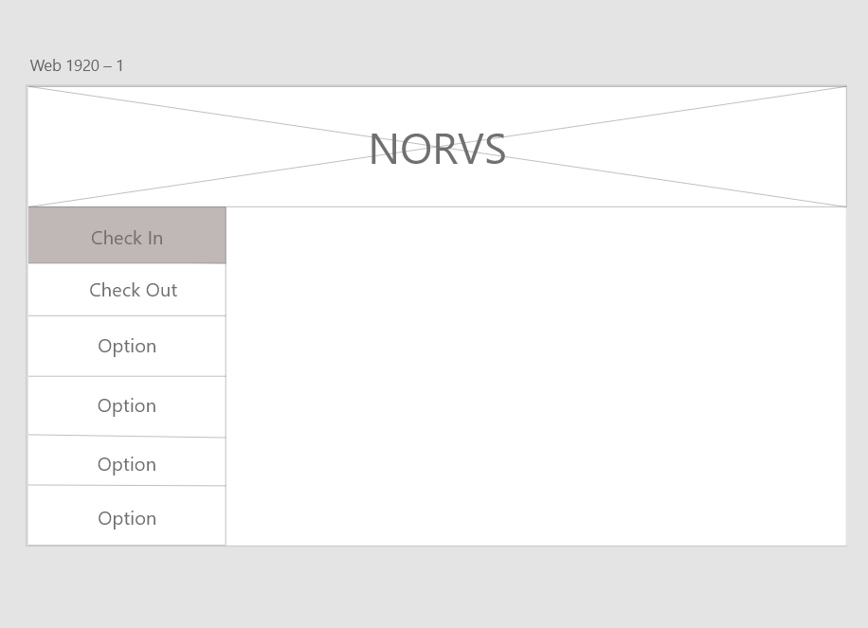
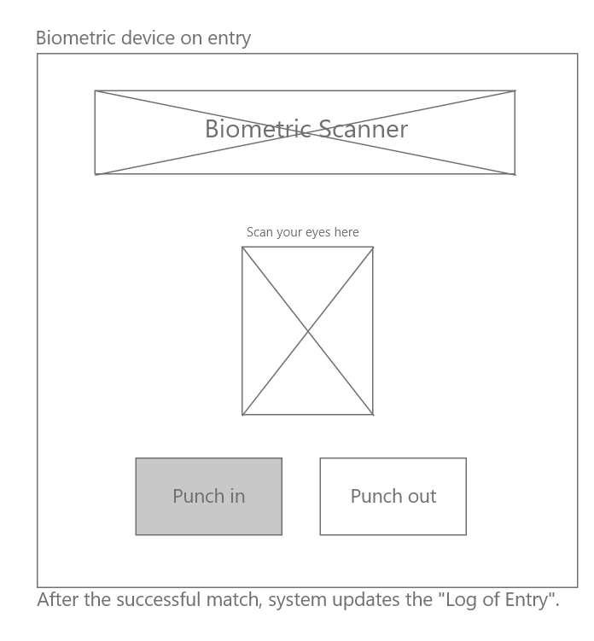
Client Entering Premises(1/2)
Index page for scanner
User chooses punch In/Out here

Slide 15
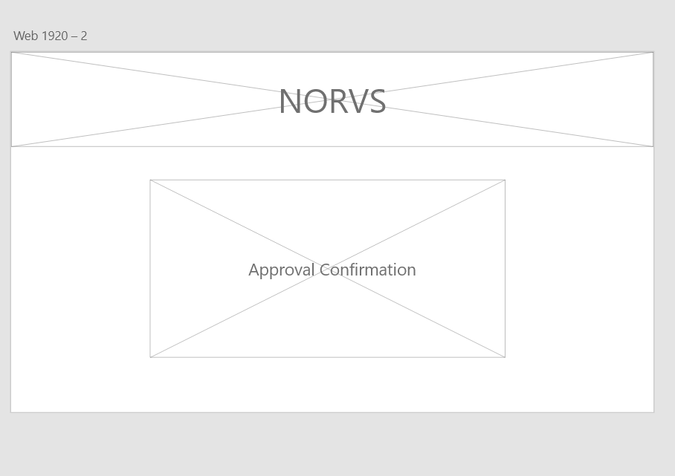
Client Entering Premises(2/2)
At, last system will show confirmation.

Slide 16
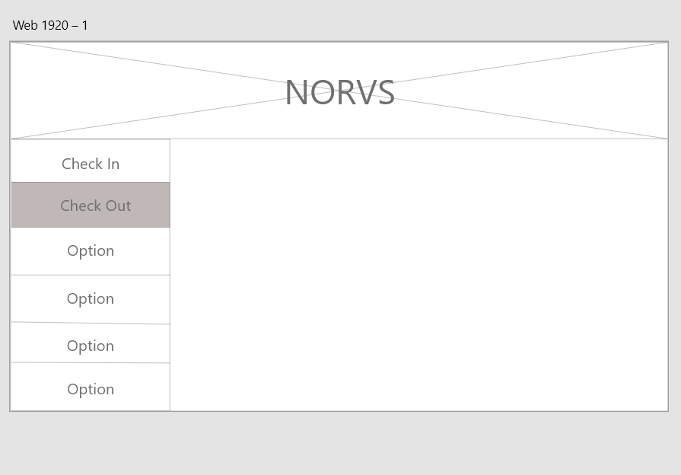
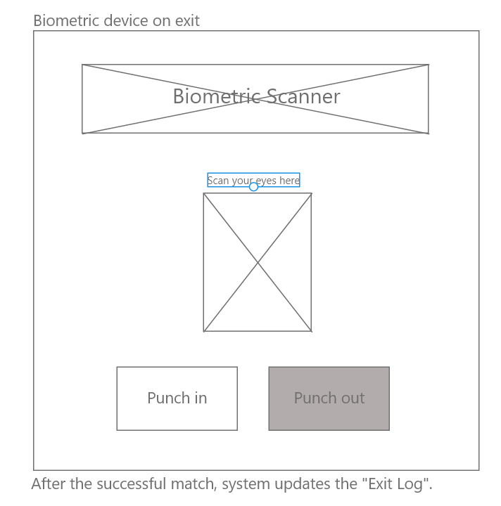
Client Leaving Premises(1/2)
Index page for scanner
User chooses punch In/Out here

Slide 17
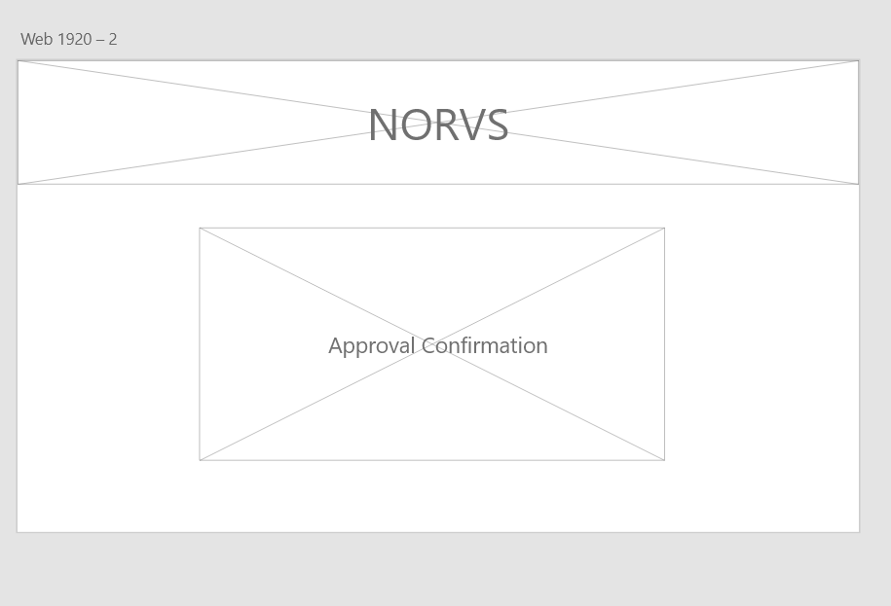
Client Leaving Premises(2/2)
At, last system will show confirmation.

Slide 18
UI summary
UI FOR OUR NORVS SYSTEM IS WELL UNDERSTOOD AND EASY TO USE, IT DOESN’T REQUIRE ANY HIGH TECHNICAL KNOWLEDGE TO OPERATE OUR WEBSITE. HERE, SIMPLICITY IS OUR KEY.

Slide 19
Summary Reports
Space Rental Report
Client Info Report
Reservation Report
Steven

Slide 20
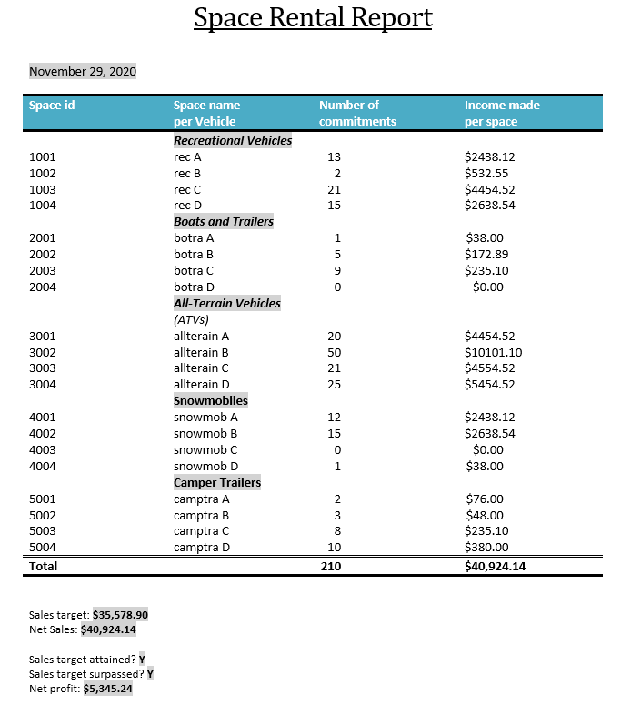
Space Rental Report
Steven

Slide 21
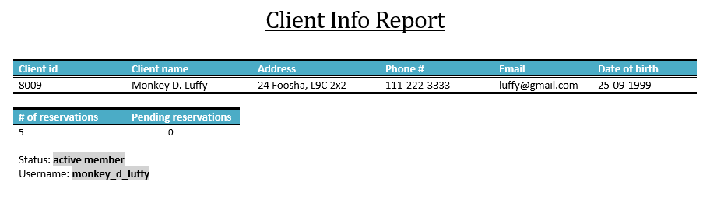
Client Info Report
Steven

Slide 22
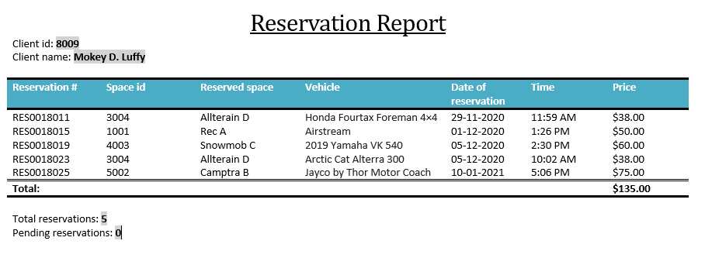
Reservation Report
Steven

Slide 23

What Did We Talk About?
Overall user interface structure of the system
Four main features including the detailed UI design for these use cases
Benefits to the company by implementing the new information system
Proposed system architecture
Three examples of the reports the system will provide and why they are beneficial.
Steven

Slide 24
NORVS
THANK YOU
CASE STUDY

